Slide 1





The Giggle Gang
Tadeáš Vykopal, Veronika Smékalová, Michal Hřebačka

Slide 2




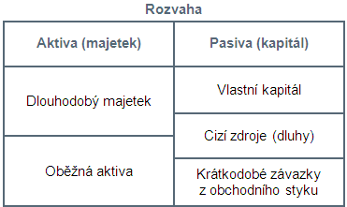
Tadeáš Vykopal
aka AI (actually intelligent)
skillz: vše na max
skill issues: aktiva a pasiva
udělal: velkou VELKOU většinu
AI

Slide 3
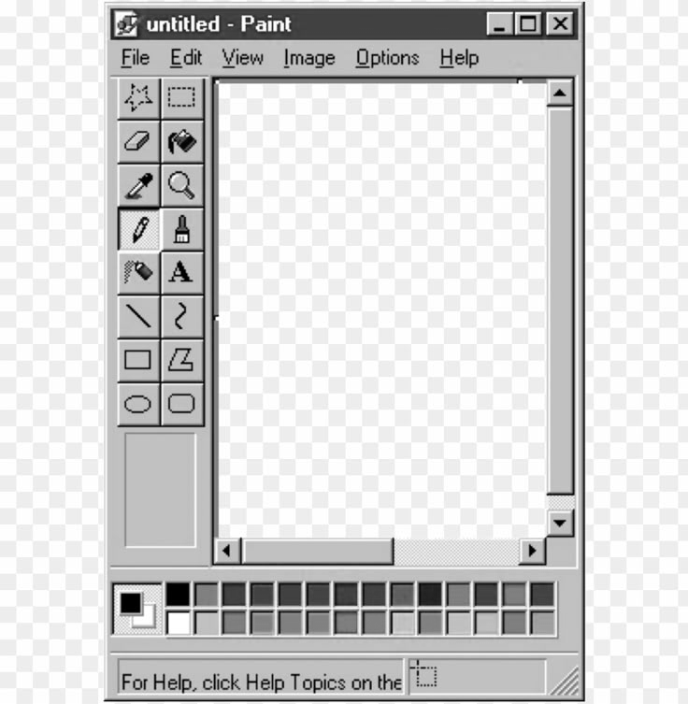
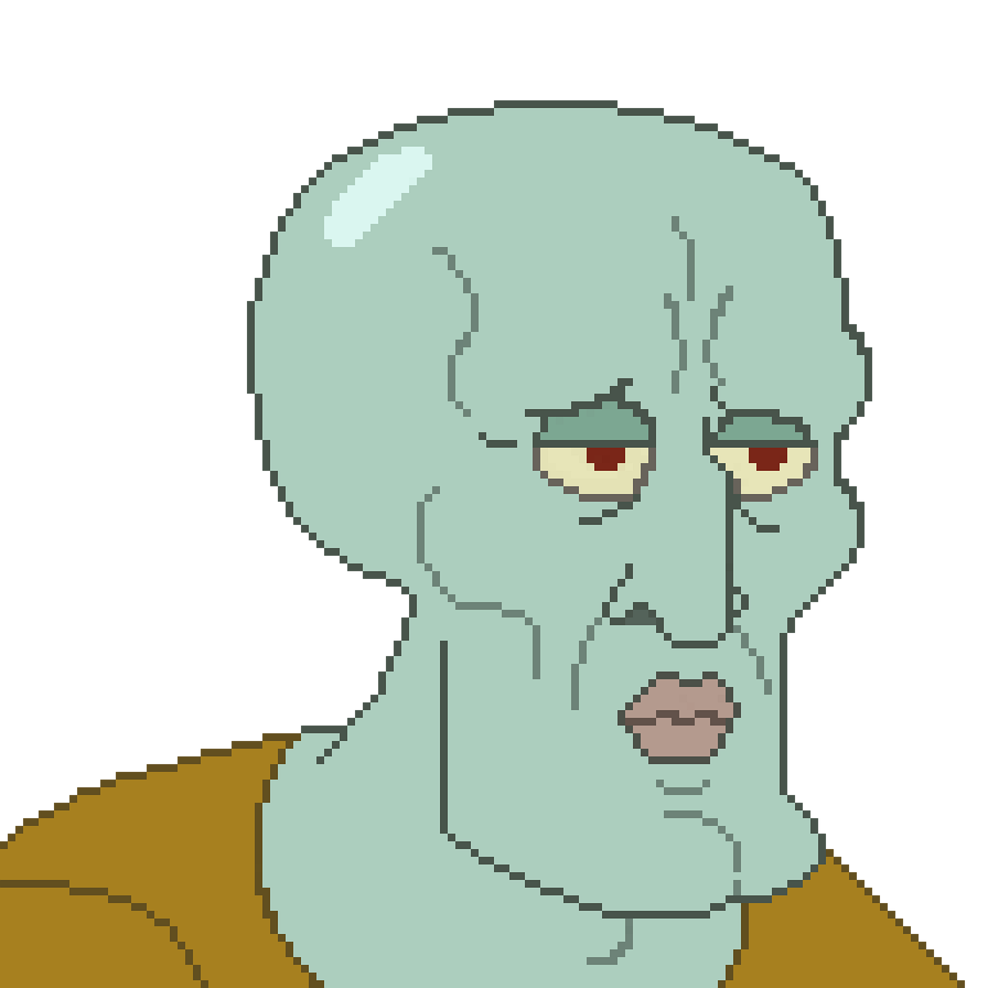



Veronika Smékalová
aka art shit person
skillz: Aseprite
skill issues: art block
udělala: tilemaps, sprite recolor

Slide 4


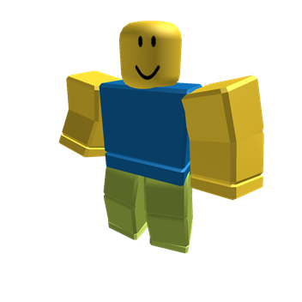


Michal Hřebačka
aka Ten co nedošel
skillz: Roblox a TikTok
skill issues: dostavit se
udělal: NULL;

Slide 5



The Legend of The Blade
01010100 01101000 01100101 00100000 01000111 01101001 01100111 01100111 01101100 01100101 00100000 01000111 01100001 01101110 01100111 00100000 00001010 01010100 01101000 01100101 00100000 01001100 01100101 01100111 01100101 01101110 01100100 00100000 01101111 01100110 00100000 01010100 01101000 01100101 00100000 01000010 01101100 01100001 01100100 01100101
projektová hra
od The Giggle Gang

Slide 6


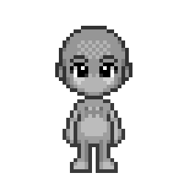
Obsah
popis
výběr a cíl
sprites
tilemapy
kód
zhodnocení
01010100 01101000 01100101 00100000 01000111 01101001 01100111 01100111 01101100 01100101 00100000 01000111 01100001 01101110 01100111 00100000 00001010 01010100 01101000 01100101 00100000 01001100 01100101 01100111 01100101 01101110 01100100 00100000 01101111 01100110 00100000 01010100 01101000 01100101 00100000 01000010 01101100 01100001 01100100 01100101
AI (actually intelligent)
art shit person
Ten co nedošel

Slide 7
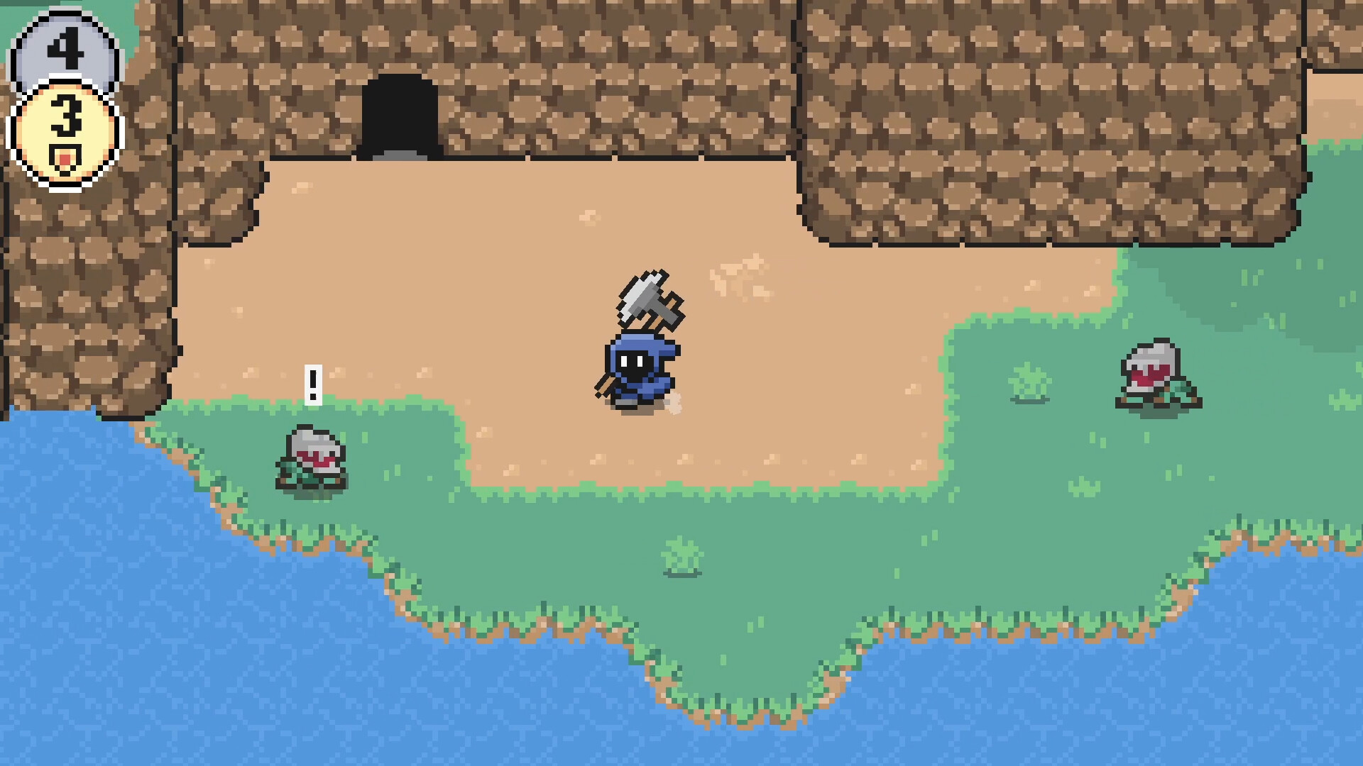
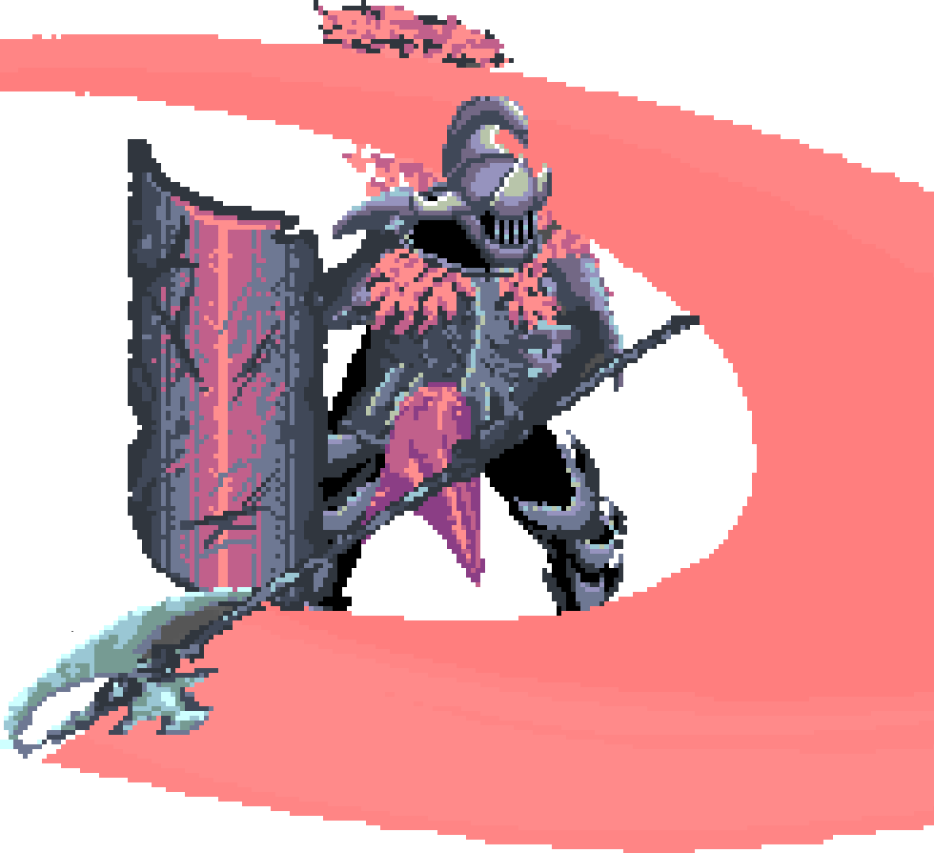

Popis
akční souls-like
pixel art grafika
top-down pohled
inspirace:
Eldest Souls
Moonshire

Slide 8
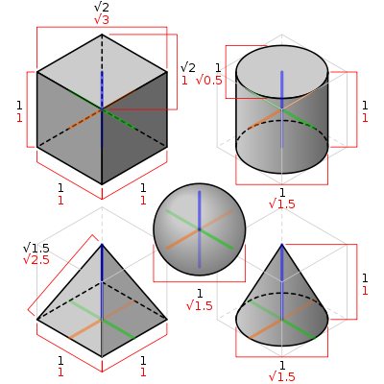


Výběr
máme blbé nápady
nechtěli jsme se dělat s 3D
máme zkušenosti
01010100 01101000 01100101 00100000 01000111 01101001 01100111 01100111 01101100 01100101 00100000 01000111 01100001 01101110 01100111 00100000 00001010 01010100 01101000 01100101 00100000 01001100 01100101 01100111 01100101 01101110 01100100 00100000 01101111 01100110 00100000 01010100 01101000 01100101 00100000 01000010 01101100 01100001 01100100 01100101

Slide 9


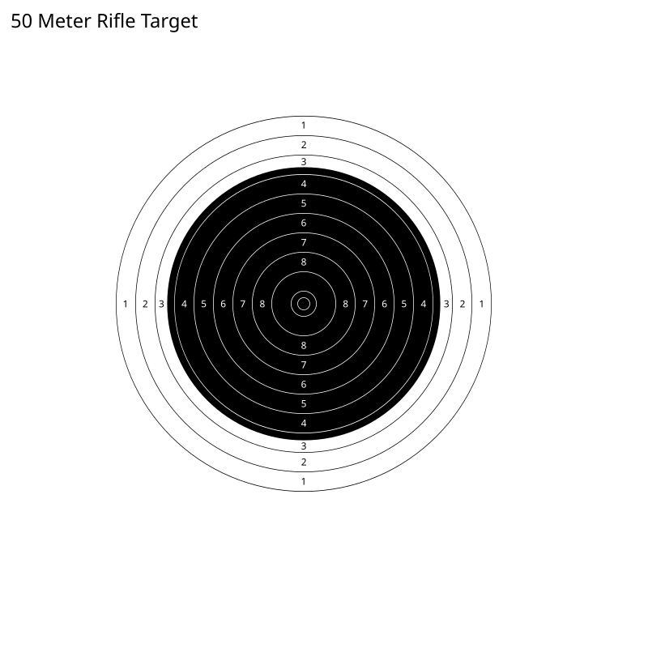
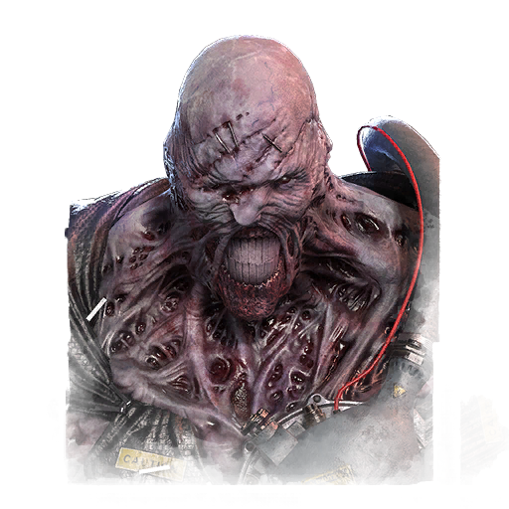
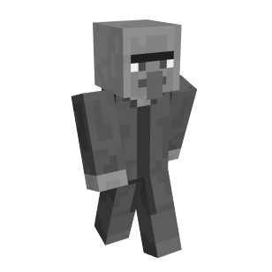


Cíl
akční souls-like funkční hra
souboje s neustále evolvujícími se bossy
získávat suroviny k vylepšování zbraní
side questy a NPC‘s

Slide 10
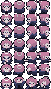




Sprites
mainCharacterSyndrome
hlavní postava:
mainCharacterSyndrome
nepřátelé:
cFlam
cSkeleton
cSpirit
cStatue
cFlam
cSkeleton
cSpirit
cStatue

Slide 11







trees

Slide 12
Tilemapy
bottom(ass)-bushes
bushes
bigger-grass-breakable
fancy-grass-breakable
flowers
grass
grass-decors
grass-edge
grass-edge-2
small-grass-breakable
stairs-left
stairs-right
tiles
tiles-edge
tiny-rocks
walls-rocky

Slide 13


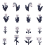




bushes
grass-decor
flowers
small-grass-breakable
grass
fancy-grass
-breakable
bigger-grass
-breakable

Slide 14
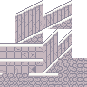

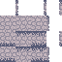
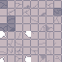

stairs-left
tiles-edge
walls-rocky
tiles
tiny-rocks

Slide 15
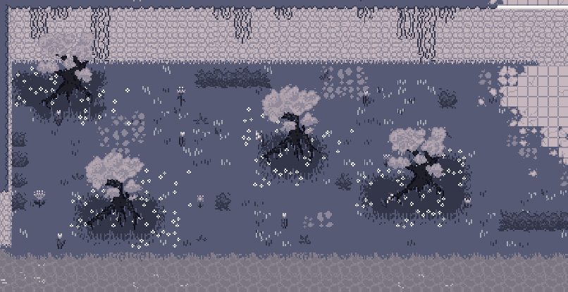
užití tilemap

Slide 16
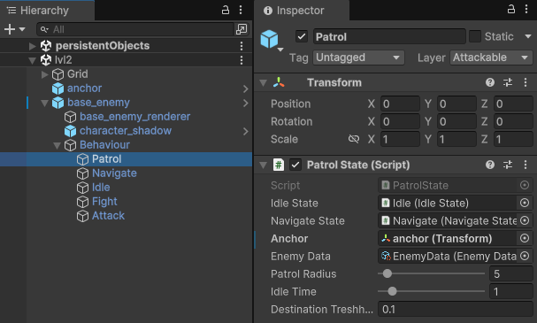
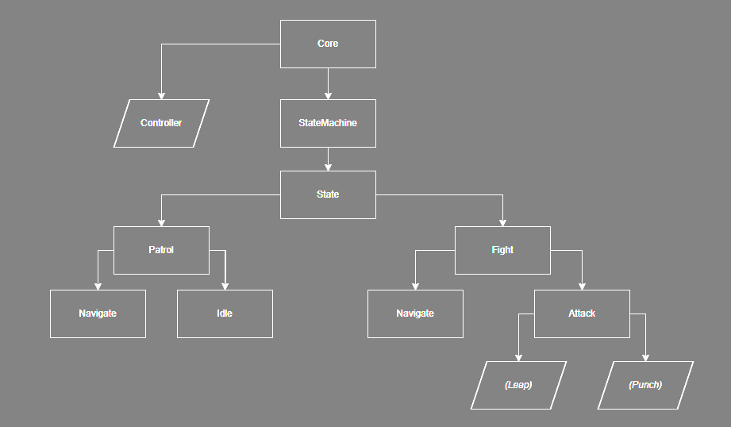
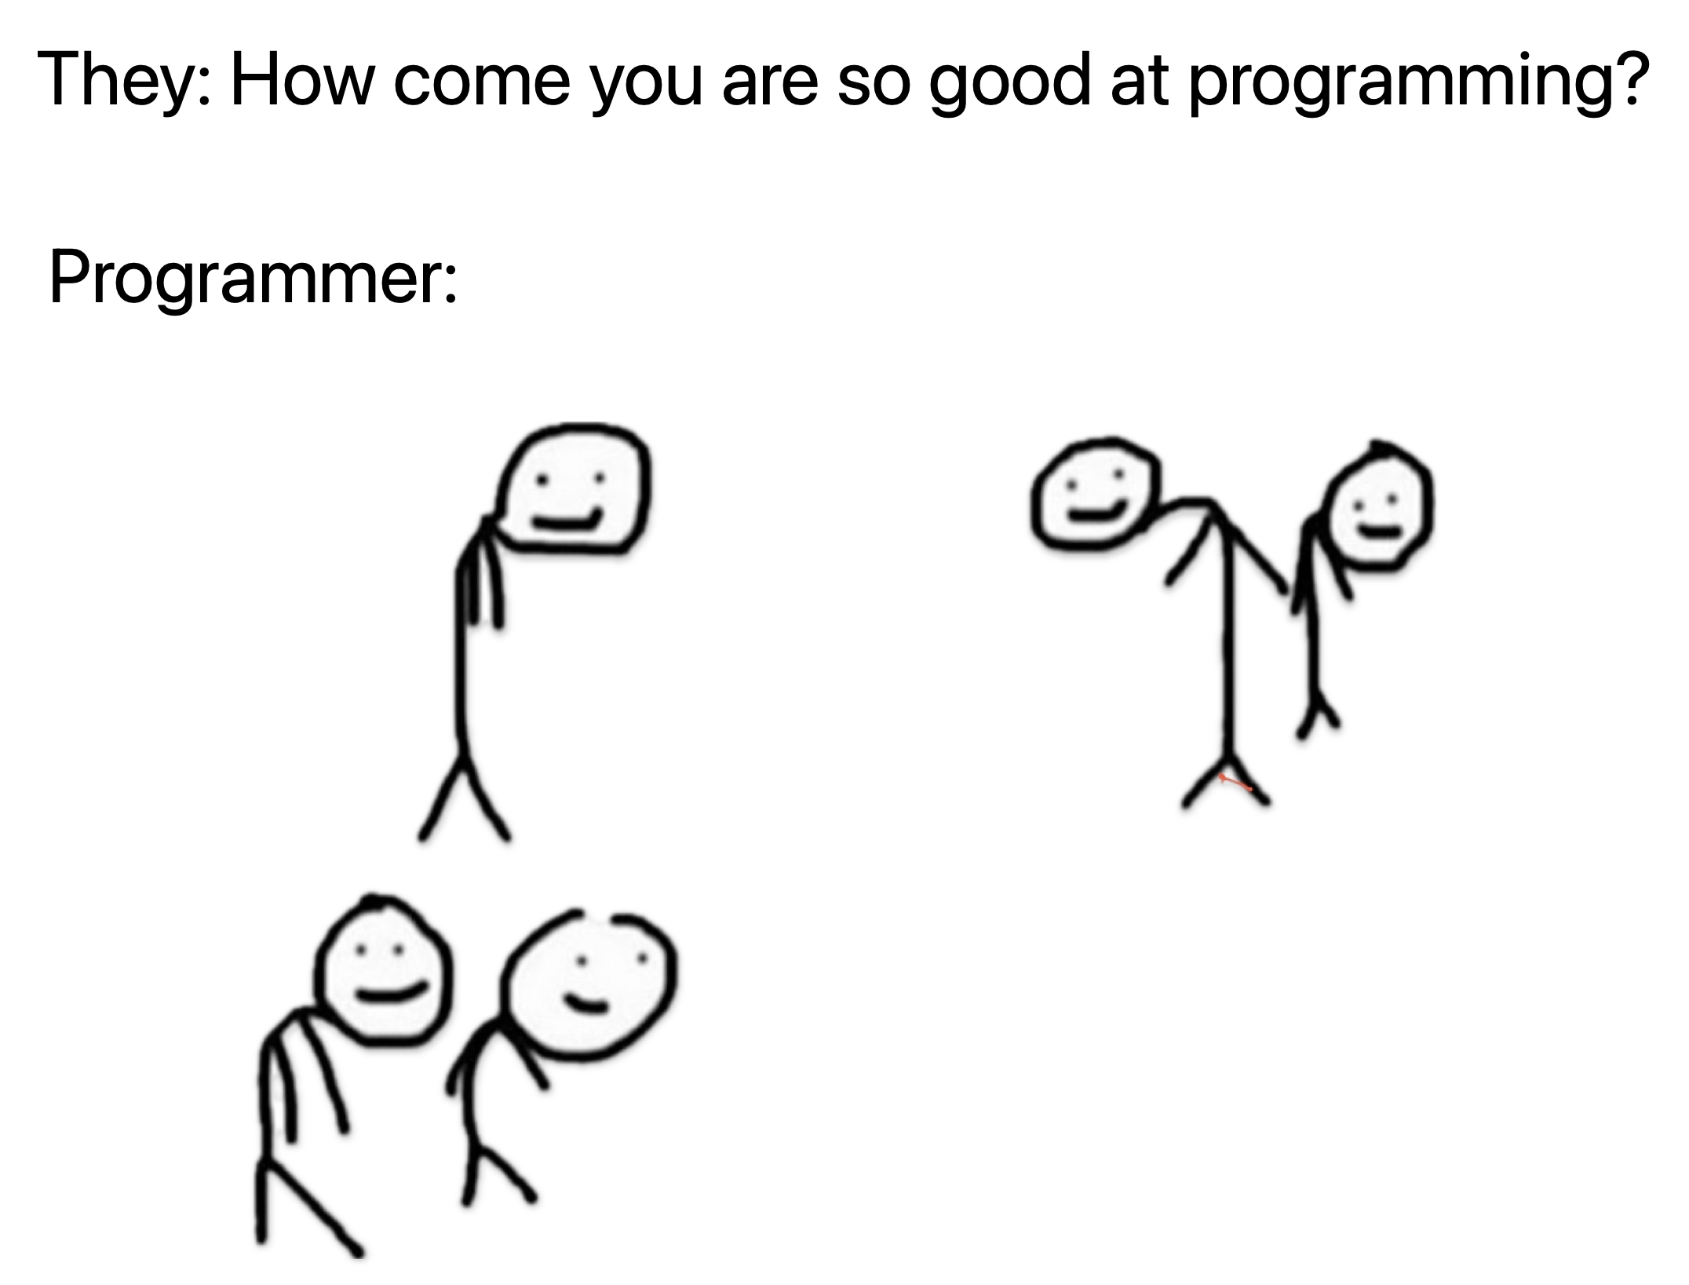
Object-based hierarchical state machine

Slide 17
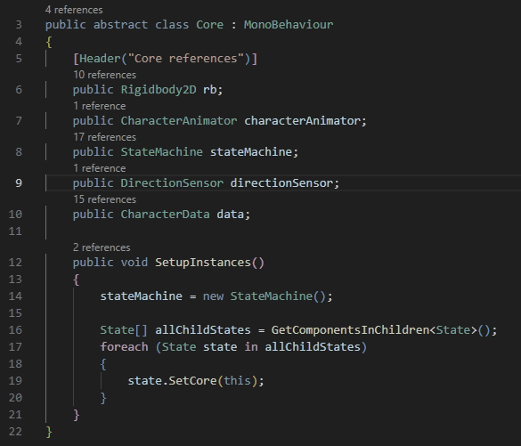
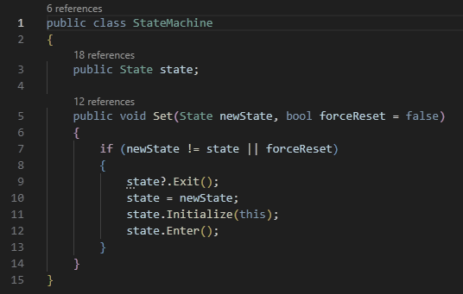
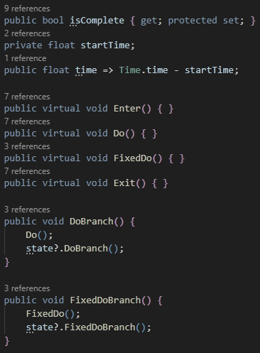
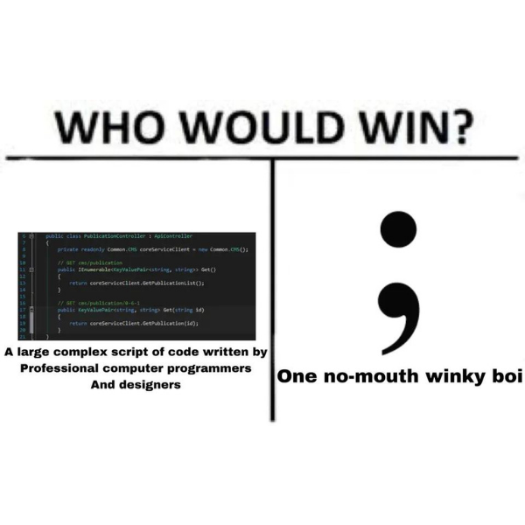
Object-based hierarchical state machine
Core
StateMachine
State

Slide 18
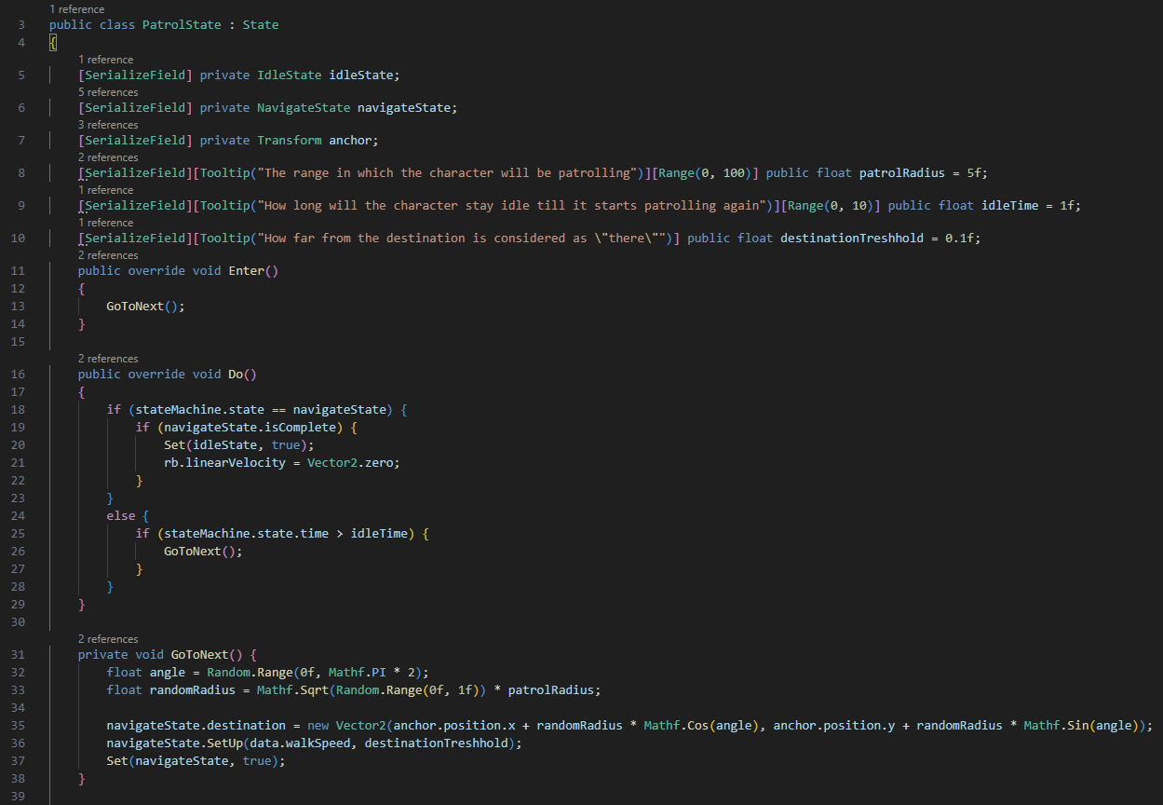
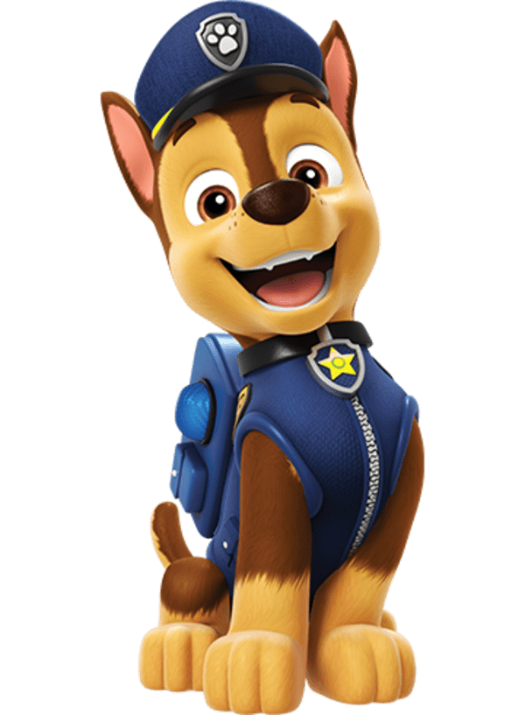
Patrol state

Slide 19
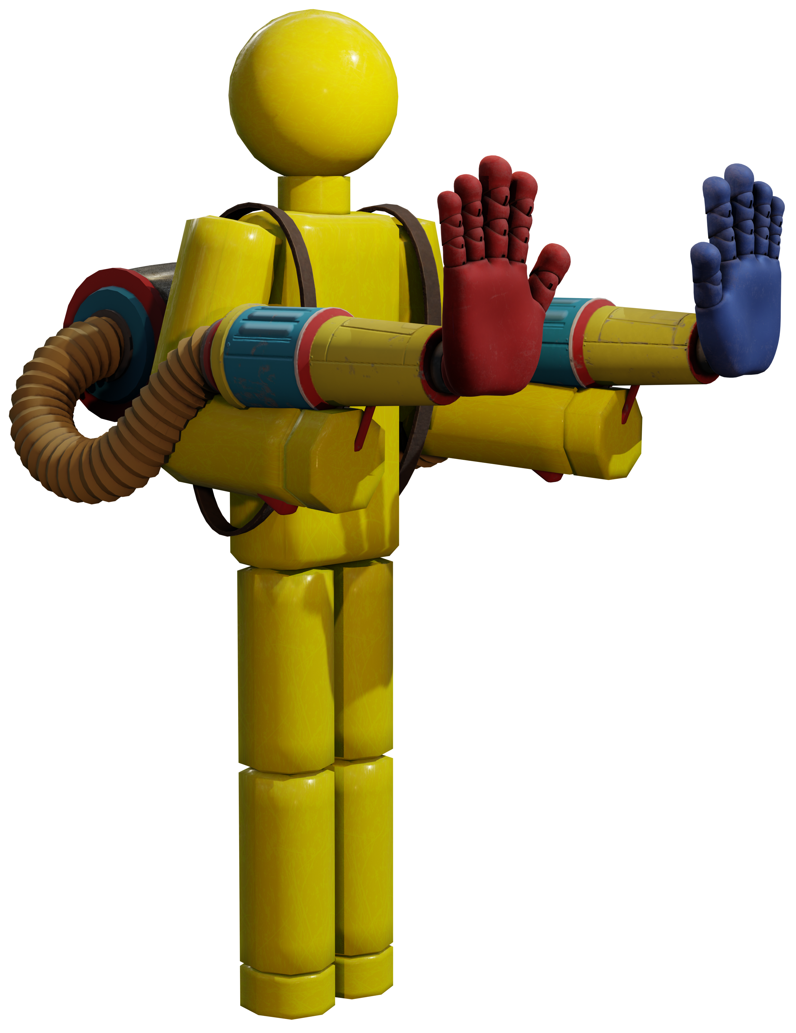
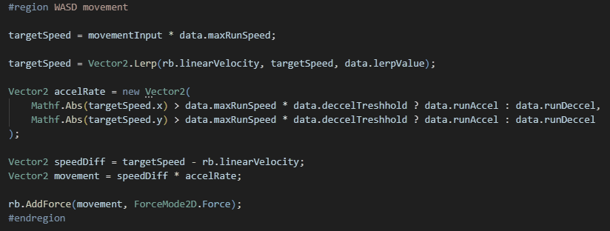
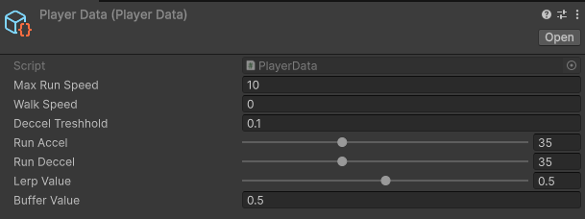

Player movement

Slide 20
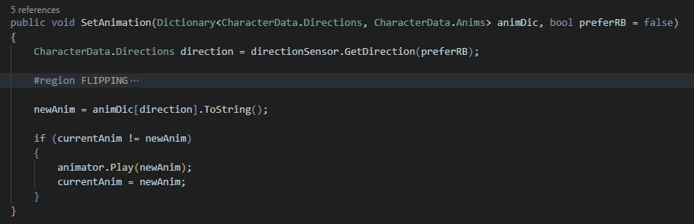
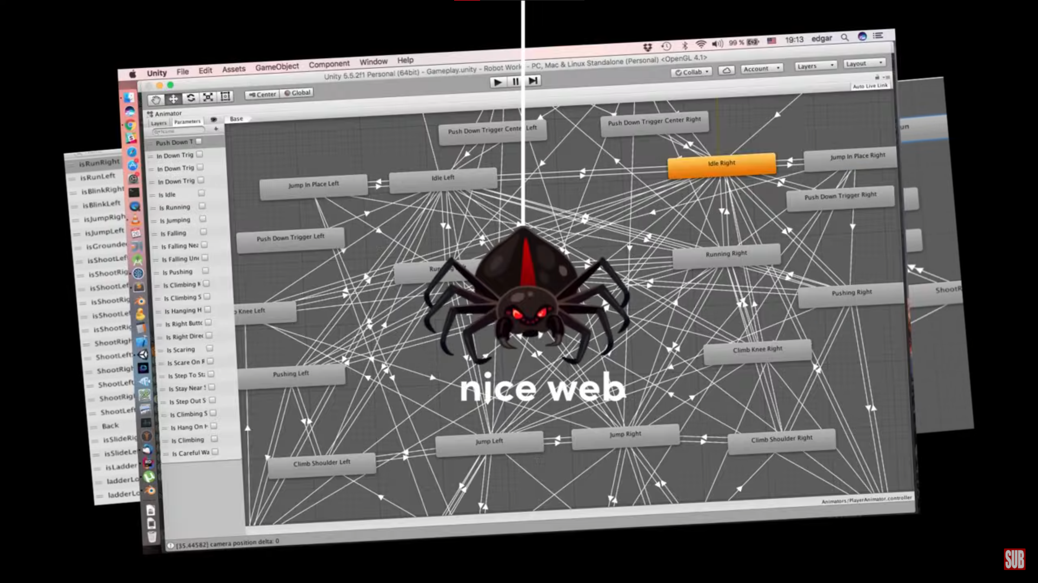
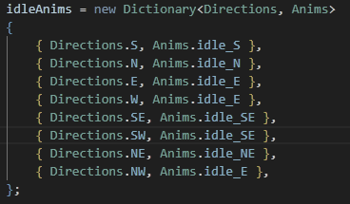
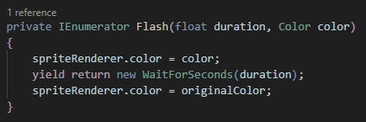
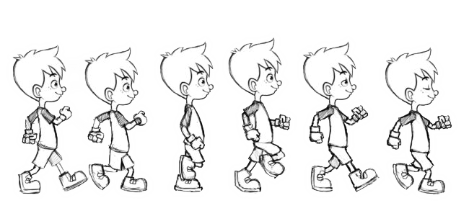
Animator

Slide 21

Zhodnocení
optionally hratelná hra
vypadá pěkně
původní cíl jsme úplně nesplnili
každý si z toho vzal své
01010100 01101000 01100101 00100000 01000111 01101001 01100111 01100111 01101100 01100101 00100000 01000111 01100001 01101110 01100111 00100000 00001010 01010100 01101000 01100101 00100000 01001100 01100101 01100111 01100101 01101110 01100100 00100000 01101111 01100110 00100000 01010100 01101000 01100101 00100000 01000010 01101100 01100001 01100100 01100101
AI (actually intelligent)
art shit person
Ten co nedošel

Slide 22

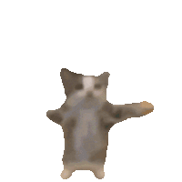










Prostor pro otázky
List<string> otazky = new List<string>();
Console.WriteLine("Zadejte otázku:");
otazky.Add(Console.Readline());
foreach(string otazka in otazky)
{
Ask(otazka);
}

Slide 23


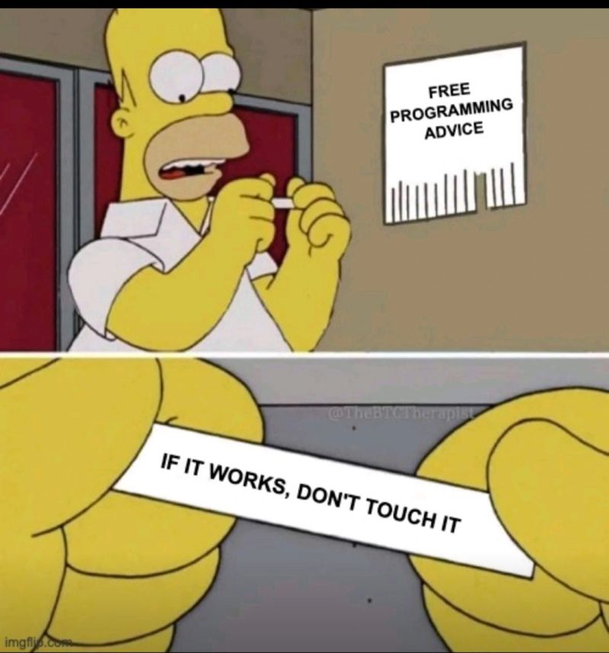
Děkujeme za pozornost
01010100 01101000 01100101 00100000 01000111 01101001 01100111 01100111 01101100 01100101 00100000 01000111 01100001 01101110 01100111 00100000 00001010 01010100 01101000 01100101 00100000 01001100 01100101 01100111 01100101 01101110 01100100 00100000 01101111 01100110 00100000 01010100 01101000 01100101 00100000 01000010 01101100 01100001 01100100 01100101
The Giggle Gang

Slide 24
Zdroje
escape animator hell: https://www.youtube.com/watch?v=nBkiSJ5z-he
animation: https://www.youtube.com/watch?v=hkaysu1Z-N8
new input system: https://www.youtube.com/watch?v=Yjee_e4fICc
tilemaps: https://www.youtube.com/watch?v=g83_gwEO0kM
acceleration: https://www.youtube.com/watch?v=KKGdDBFcu0Q
overall enemies: https://www.youtube.com/watch?v=d002CljR-KU
melee combat: https://www.youtube.com/watch?v=sPiVz1k-fEs
health/healthbar: https://www.youtube.com/watch?v=yxzg8jswZ8A&list=PLgOEwFbvGm5o8hayFB6skAfa8Z-mw4dPV&index=7
lights: https://www.youtube.com/watch?v=1h-hSlffawM
save/load system: https://www.youtube.com/watch?v=XOjd_qU2Ido
overall enemies: https://www.youtube.com/watch?v=d002CljR-KU
bettergame steps: https://www.youtube.com/watch?v=3y-ldI_xWiI
adaptive difficulty: https://www.youtube.com/watch?v=rI7UxiEZbA4&list=PLqPLyUreLV8C59RyVDRESJtefspPi-eXq&index=45
coloooooor: https://www.youtube.com/watch?v=jqUoh69Aawc, https://www.youtube.com/watch?v=jEWFSv3ivTg
input system: https://www.youtube.com/watch?v=Pzd8NhcRzVo2D
pathfinding AI: https://www.youtube.com/watch?v=jvtFUfJ6CP8&t

Slide 25
challacade devlog playlist: https://www.youtube.com/watch?v=Hmw73vcUzsg&list=PLqPLyUreLV8C59RyVDRESJtefspPi-eXq
new input system: https://gamedevbeginner.com/input-in-unity-made-easy-complete-guide-to-the-new-system/#how_to_manage_, https://www.youtube.com/watch?v=eTxgifto4EQ
screen tearing + camera follow (cinemachine): https://www.youtube.com/watch?v=kV9rVinFyAk&list=PLaaFfzxy_80HtVvBnpK_IjSC8_Y9AOhuP&index=6
assets: https://pixel-boy.itch.io/ninja-adventure-asset-pack
level design: https://www.youtube.com/watch?v=Dk9OEt02aDE
movement code inspo: https://github.com/DawnosaurDev/platformer-movement/blob/main/Platformer%20Demo%20-%20Unity%20Project/Assets/Scripts/PlayerMovement.cs
that fucking bullshit: https://docs.unity3d.com/Packages/com.unity.inputsystem@1.11/manual/RespondingToActions.html
component state machine: https://www.youtube.com/watch?v=-jkT4oFi1vk, https://www.youtube.com/watch?v=Z0fmGAQSQG8
attack: https://www.youtube.com/watch?v=816ttZXUhN0&list=PLy78FINcVmjDeHVYh8SMjEP1B_MdSLCSz&index=7
async/await: https://www.youtube.com/watch?v=WY-mk-ZGAq8
anim matching speed (15:15): https://youtu.be/-jkT4oFi1vk?si=Av0UdCqcDBBqsxHc
async scene loading/unloading: https://www.youtube.com/watch?v=6-0zD9Xyu5c
game UI database: https://www.gameuidatabase.com/index.php
action maps: https://www.youtube.com/watch?v=NZBAr_V7r0M
scene transitions: https://youtu.be/CE9VOZivb3I?si=TIOQBFR7X-6O_Ih0
ChatGPT

